Slide 1


Battle-Hardened AI
Full details in: https://github.com/yuhisern7/battle-hardened-ai

Slide 2
The Details Here Are ANTI-MARKETING
This document is written for people who understand first-layer enforcement, gateways, and control planes. It assumes familiarity with firewalls, routing, kernel telemetry, and pre-execution decision systems.
Nothing in Battle-Hardened AI is designed as a marketing gimmick: every term (21 layers, semantic execution-denial, trust graph, causal inference) corresponds to concrete modules, code paths, and enforcement points that can be inspected in this repository and its documentation.

Slide 3
Summary Highlights
Blocks malicious actions before execution using a 21-layer AI ensemble and a final semantic execution-denial gate.
Acts as a first-layer firewall commander for gateways and routers, deciding what should be blocked while delegating actual enforcement to the local firewall control plane.
Works without agents, exporting neutral JSON that plugs into existing SIEM, SOAR, firewall, and XDR stacks.
Provides documented coverage for 43 MITRE ATT&CK techniques via pre-execution denial and trust degradation.
Built for enterprise, government, and national-security defense use cases where autonomy, auditability, and privacy are mandatory.
Optionally connects to a central relay/VPS where many Battle-Hardened AI nodes share only sanitized attack patterns and receive model/signature updates, so global learning improves over time without any customer content or PII leaving local infrastructure.

Slide 4
Executive Summary
Stop breaches before they start: Battle-Hardened AI sits at the gateway and decides what is allowed to execute, blocking malicious activity before it reaches servers, endpoints, or data.
Reduce analyst load, not add to it: It runs autonomously with explainable decisions and conservative defaults, cutting noise instead of generating more alerts.
Integrate with what you already have: Decisions are exported as simple JSON and enforced through existing firewalls, SIEM, SOAR, and EDR/XDR tools—no rip-and-replace.
Protect privacy and sovereignty: Detection happens on your infrastructure, and when the optional relay to the central VPS is enabled, only anonymized patterns and statistics are shared—no raw payloads, credentials, or customer data.

Slide 5
New Category of Security
A first-layer autonomous execution-control system that operates at the router and gateway boundary, making pre-execution decisions with full context—semantic, behavioral, and causal—before any downstream tool is engaged.
We are not aware of any publicly documented enterprise-grade system that:
Operates as a first-layer gateway authority
Performs semantic execution validation
Maintains persistent trust memory
Uses causal inference to command routers and firewalls prior to execution

Slide 6
What Battle-Hardened AI Is Not
To remain strictly focused as a first-layer decision system, Battle-Hardened AI does not:
Act as a SIEM (log aggregator)
Act as a SOAR (workflow orchestrator)
Act as an EDR (host process monitor)
Act as an IAM (identity manager)
Act as a threat intel aggregator
It makes execution decisions only.

Slide 7
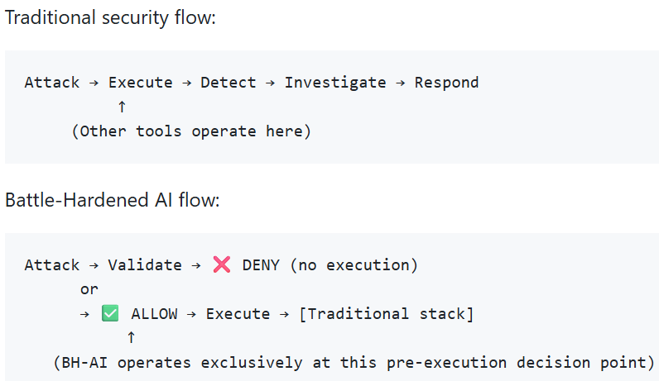
What Makes Us Different
Most platforms react after execution. Battle-Hardened AI intervenes before.
Comparison: Execution Timing:

Slide 8
Competitive Landscape
Battle-Hardened AI is designed to sit in front of, and alongside, existing controls rather than replace them.
Versus firewalls (NGFW/WAF): Traditional firewalls enforce static or signature-based rules on packets and sessions. Battle-Hardened AI acts as a semantic commander in front of them, deciding whether an interaction should be allowed at all and then driving firewall rules accordingly.
Versus NDR/XDR: NDR/XDR platforms aggregate telemetry and raise alerts after execution. Battle-Hardened AI operates at the execution gate, using 21 documented layers plus the semantic execution-denial gate to reject malicious actions before they reach those systems.
Versus SD-WAN and routing gear: SD-WAN optimizes paths and connectivity between sites. Battle-Hardened AI focuses purely on security semantics and trust, determining which flows should exist at all and leaving path selection to the network layer.
Versus EDR (agent-based): EDR agents live on individual endpoints and watch local processes. Battle-Hardened AI typically runs as a gateway node with no agents, protecting many devices at once and exporting decisions that EDR/XDR tools can still consume.

Slide 9
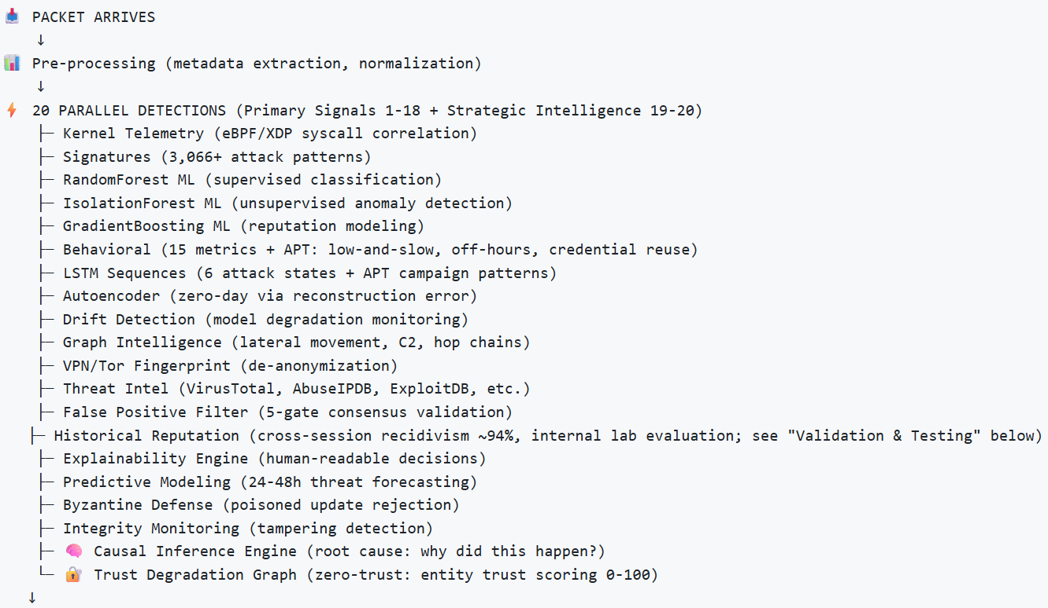
The Flow of BH-AI (part 1)

Slide 10
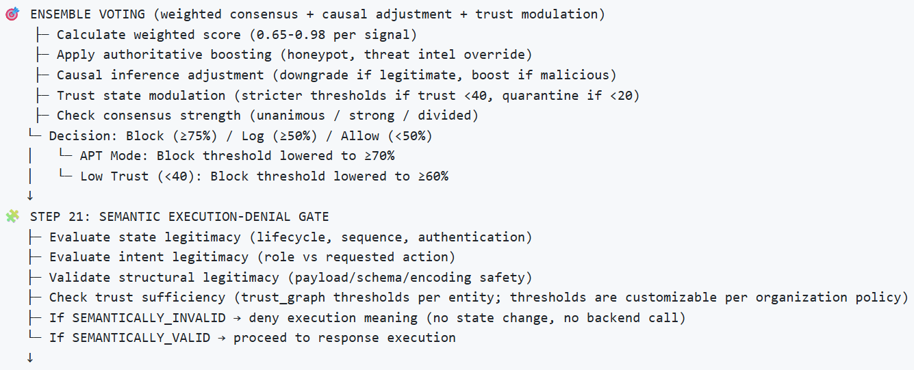
The Flow of BH-AI (part 2)

Slide 11
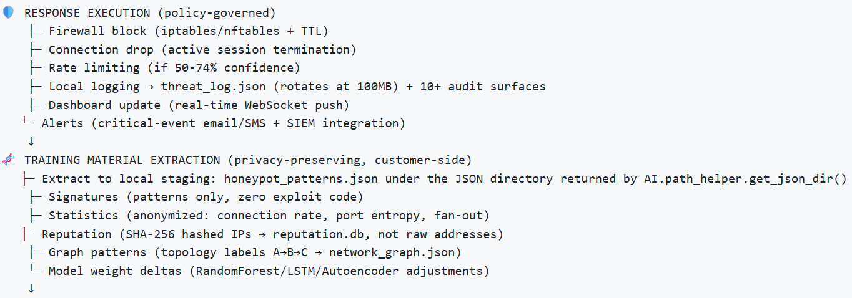
The Flow of BH-AI (part 3)

Slide 12
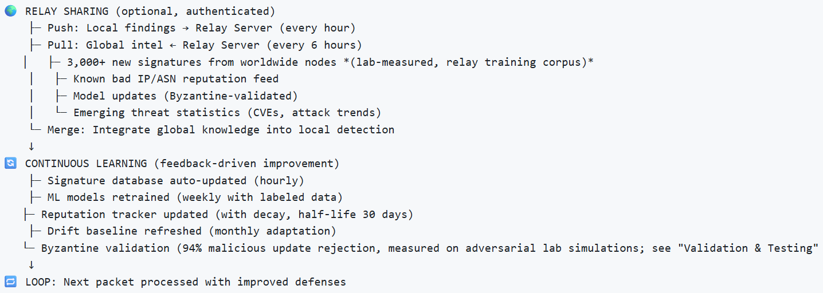
The Flow of BH-AI (part 4)

Slide 13
Customer Nodes
Push sanitized threat summaries and extracted patterns to a centrally-operated relay/VPS over WebSocket (typically wss://<relay-host>:60001) using a dedicated relay client; no raw payloads, logs, or customer data are ever sent.
Pull only pre-trained models and curated signature/reputation/intel bundles from an HTTPS training API (typically https://<relay-host>:60002); raw training datasets and history remain on the relay and never transit customer networks.
Load downloaded models from their local ML models directory (resolved by AI.path_helper.get_ml_models_dir()); nodes never read relay/ai_training_materials/ directly.

Slide 14
Privacy-Preserving Defensive Mesh
One server protects an entire network segment (no endpoint agents required)
Every attack makes the system smarter (automated signature extraction + ML retraining)
Every node benefits from global learning (relay-shared intelligence from worldwide attacks)
Organizations retain full control (relay participation is optional, all data anonymized)
Privacy is preserved (no raw payloads, no PII, only statistical features shared)

